Slide 1

python

Slide 2
Hello World
From IDLE create a new file
Type in the following:
print(“Hello World”)
Save the file and press F5 to run

Slide 3
Language Syntax
Most of us are aware that languages such as English, French and Spanish have their own rules. These rules make up the language grammar.
The syntax of a language is that part of the grammar which defines how sentences are constructed - words, symbols and the order in which they are used.
In a similar way, programming languages have their own syntax.
This is called the language syntax.

Slide 4
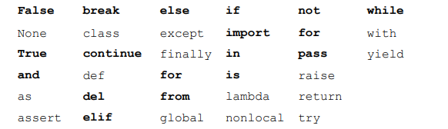
Language Syntax in Python
Python has certain vocabulary that is understands. These are keywords or commands.
There are 33 but we will only need some of them

Slide 5
Language Syntax
We can add to Python’s vocabulary by defining our own words.
Python understands white spaces, numbers and strings.
All programs must adhere to the syntax of the programming language. Otherwise it contains a syntax error.
If you try to run a program that has a syntax error, Python displays a syntax error message.

Slide 6
Comments
Comments are a way to tell Python to ignore syntax.
Comments are very important and improve readability of code.
In Python comments start with the hash character, #.
When Python comes across the hash character, it ignore the rest of the line.

Slide 7

Basic Syntax
Try running the following
Print(“Hello World”)
What happens?
Try each of the following separately

Slide 8
Python Syntax
Python is not fussy about what you type inside quotation marks.
Outside quotation mark, Python is very limited in what it understands.
However it does understand numbers, they do not have to be inside quotations.

Slide 9
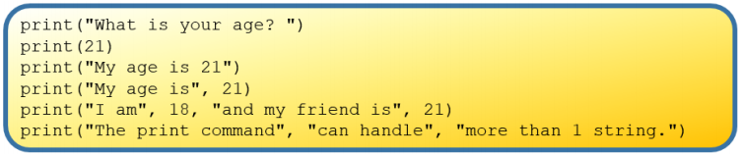
Python Syntax

Slide 10
Keyword - String
The technical word for text is string.
A string is any text enclosed inside quotation marks.

Slide 11
Python Profile
Python Likes….
Numbers, Whitespaces, Commands, Keywords, Strings, Operators
Rules and Order

Slide 12

Escape Sequences
This does not work as Python thinks the second quotation closes the first and so the remainder of the line is not understood.
To fix the syntax, we escape the second quotation using the backslash character, \

Slide 13
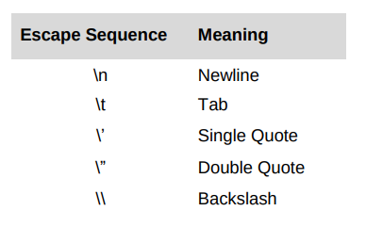
Escape Sequences
The use of \” tells Python to include the double quotes as part of the string.
Some common escape sequence characters are

Slide 14

Try the following

Slide 15
End Users
An end user is the person/people for whom a software system is developed.
End users are the customer and typically do not know how to program.
It is important to bear the needs of the end user in mind when designing and implementing code.

Slide 16
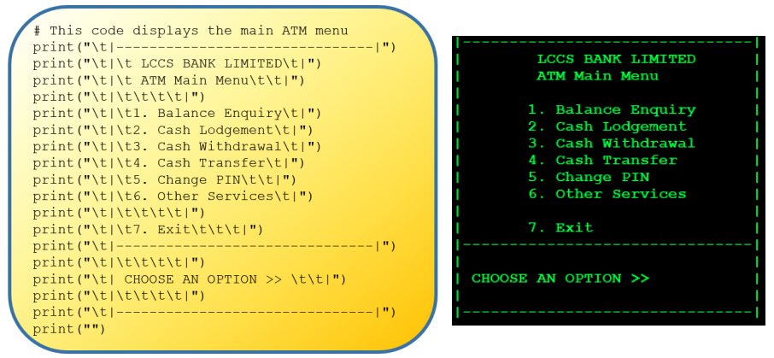
ATM Display system
Menu Example

Slide 17
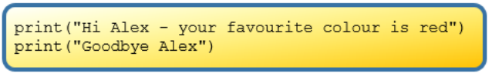
Variables
If we wanted to write a program that displayed a personalised message, we could write:
The person’s name appears twice which gives rise to the possibility of mismatched spelling.
We would also have to change the name is two places if we wanted to change the name.

Slide 18
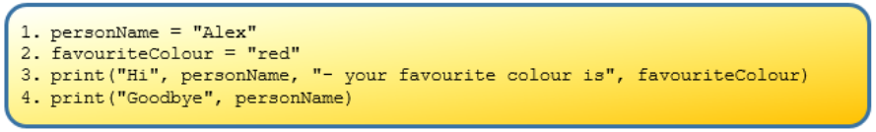
The variables are declared/initialised on Line 1 and 2
Line 3 displays the contents of the variables in a string.
Note: The names of the variables appear outside the double quotations, and commas are used to delimit the variables from the greeting string.

Slide 19
Variables
The program is considered better because the person’s name only needs to be keyed in once by the programmer.
However, it still only works for one person and one colour so everytime we want to display a different name, we need to change the program.
A more general solution would be to ask the user to enter their name and favourite colour.
We can do this using the input command.

Slide 20
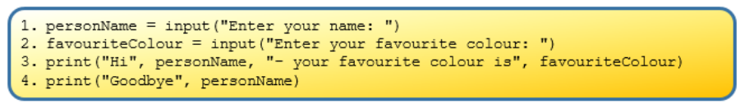
Input Command
The input command allows a user to enter a value into a running program and have that value stored in a variable.
Everytime the program is run, whatever values are entered by the end-user are stored in the variables personName and favouriteColour.

Slide 21

Variable Syntax
The general syntax for declaring a variable is made up of a left hand side and a right hand side as follows:
The name of the variable appears on the left hand side and an expression appears on the right hand side. The ‘=’ symbol in the middle is the Python assignment operator.

Slide 22
Variable Syntax
The ‘=’ in Python indicates an assignment statement.
When Python comes across an assignment statement it evaluates the expression on the right hand side first. The result is stored in the variable name on the left hand side.
The expression on the right hand side can be:
A value such as a string or a number
An arithmetic expression (which can contain variables)
The name of a built-in command such as input.

Slide 23
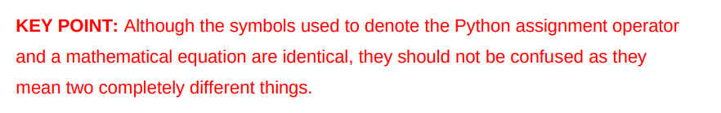
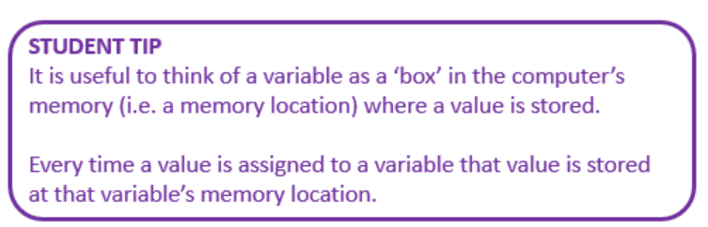

Slide 24
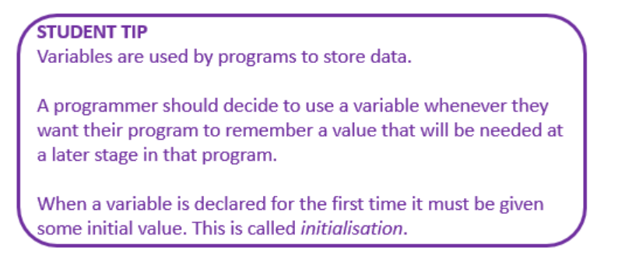

Slide 25
Rules for Naming Variables
Variable names should be simple and meaningful.
It should tell something about what the variable is used for making it more understandable to fellow programmers.
We can separate words using an underscore
Examples: first_name, high_score
Another method is to use camel case
Examples: maxTemp, payRate

Slide 26
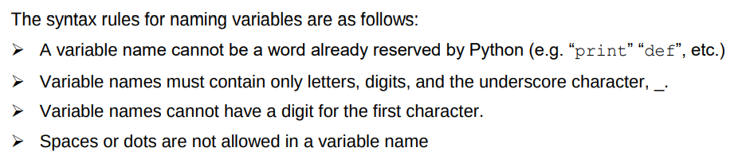
Naming Variables

Slide 27
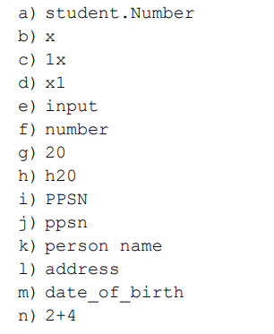

Slide 28
Datatypes and Operations
Programmers need to be aware of the type of data that their programs process.
This is referred to as datatype.
So far we have encountered string and numeric datatypes.
Python supports several different types of numbers - integers, floating point numbers as well as others including complex and rational numbers.

Slide 29
Datatypes and Operations
Every datatype in Python has a permissible set of operations that are only valid for that type.
The numeric datatype supports all the usual arithmetic operations such as addition, multiplication etc.

Slide 30
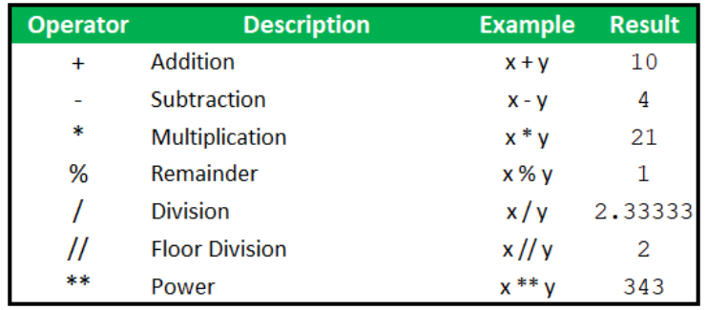
x = 7 and y = 3

Slide 31
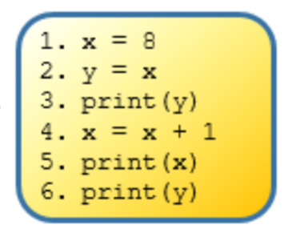
Program Tracing

Slide 32
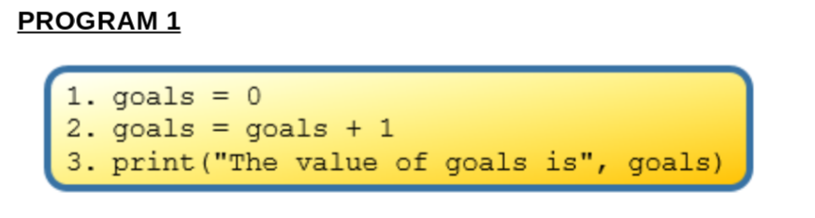

Slide 33
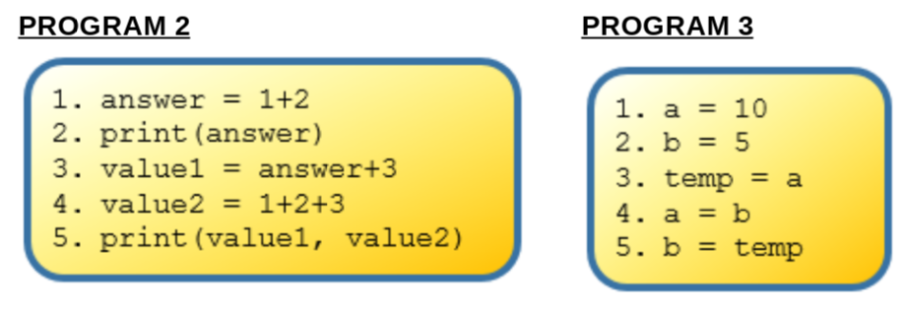

Slide 34
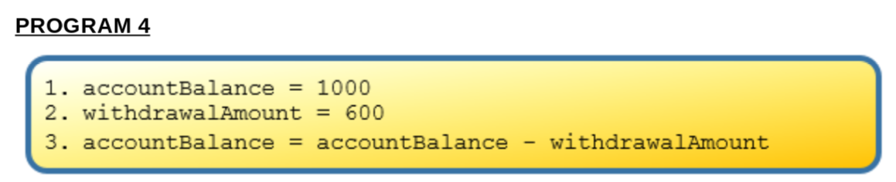

Slide 35
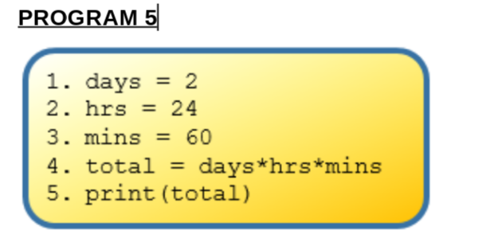

Slide 36
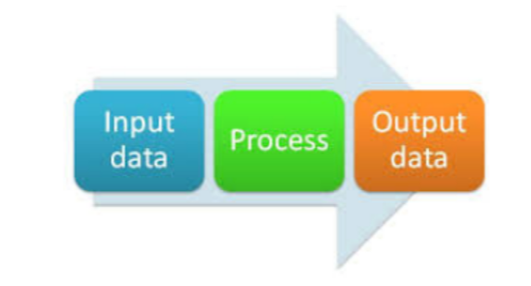
Input-Process-Output
Many computer pr
Many computer programs follow this model.
The program accepts some data, carries out some processing and display and/or stores the output

Slide 37
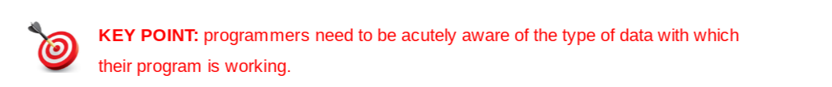
We know the input command is used to prompt the end-user to enter a value into a running program. The value entered can then be stored in a variable.
By default, the input command returns a string.
This means that if you want your program to accept numeric data, the value entered must be converted from a string to either an integer or a floating point (decimal) number.

Slide 38
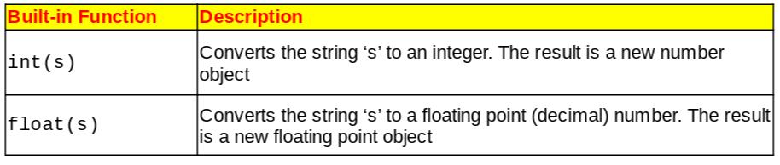
Python has two built in commands that can perform these conversions.

Slide 39
Example: Year of Birth
We want to write a program to calculate a person’s year of birth.
Our program will ask the end-user for two pieces of information - the current year and the age they will be at the end of the current year.
We will store this data in two variables: year and age
Since year and age are both numeric we will need to instruct the program to convert them from strings to integers. We use the int command to do this.

Slide 40
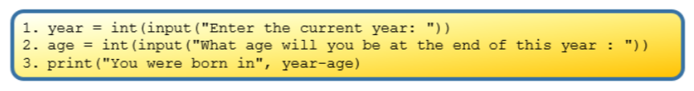

Slide 41
It is important to understand the difference between the string “2018” and the numeric value 2018.
Subtraction is supported on numbers but not on strings.
It is also worth noting that numbers can be converted to string objects using the str function.

Slide 42
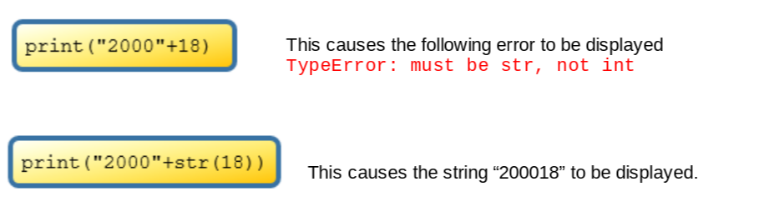
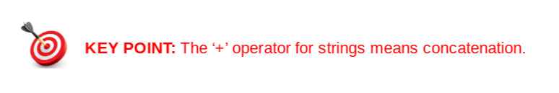

Slide 43
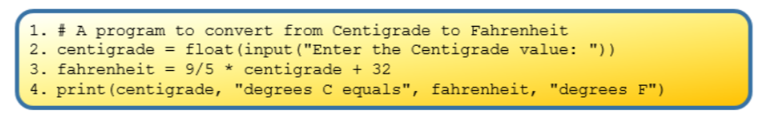
Example: Temperature Conversion

Slide 44
More built in functions
Using the temperature conversion program, try an input value of 21C.
21.0 degrees C equals 69.80000000000001 degrees F
The number of digits displayed after the decimal point is unnecessary in this case.
The level of precision displayed can be controlled by the programmer by using the round function.

Slide 45
